Slide 1
"True" Off-Policy Batch Constrained Reinforcement Learning
Samaahita Belavadi, Sutej Kulgod

Slide 2
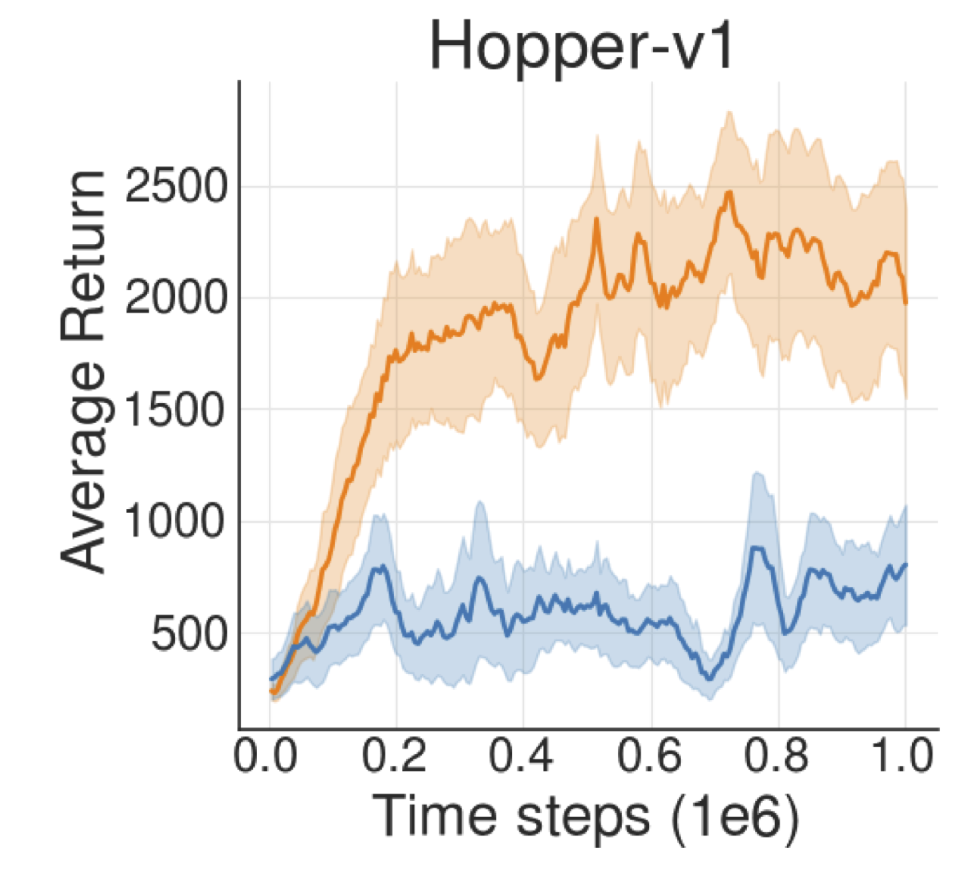
Two RL agents Orange and Blue
Looks like Orange is trained with a state of the art algorithm?
Blue undergoes no training?

Slide 3
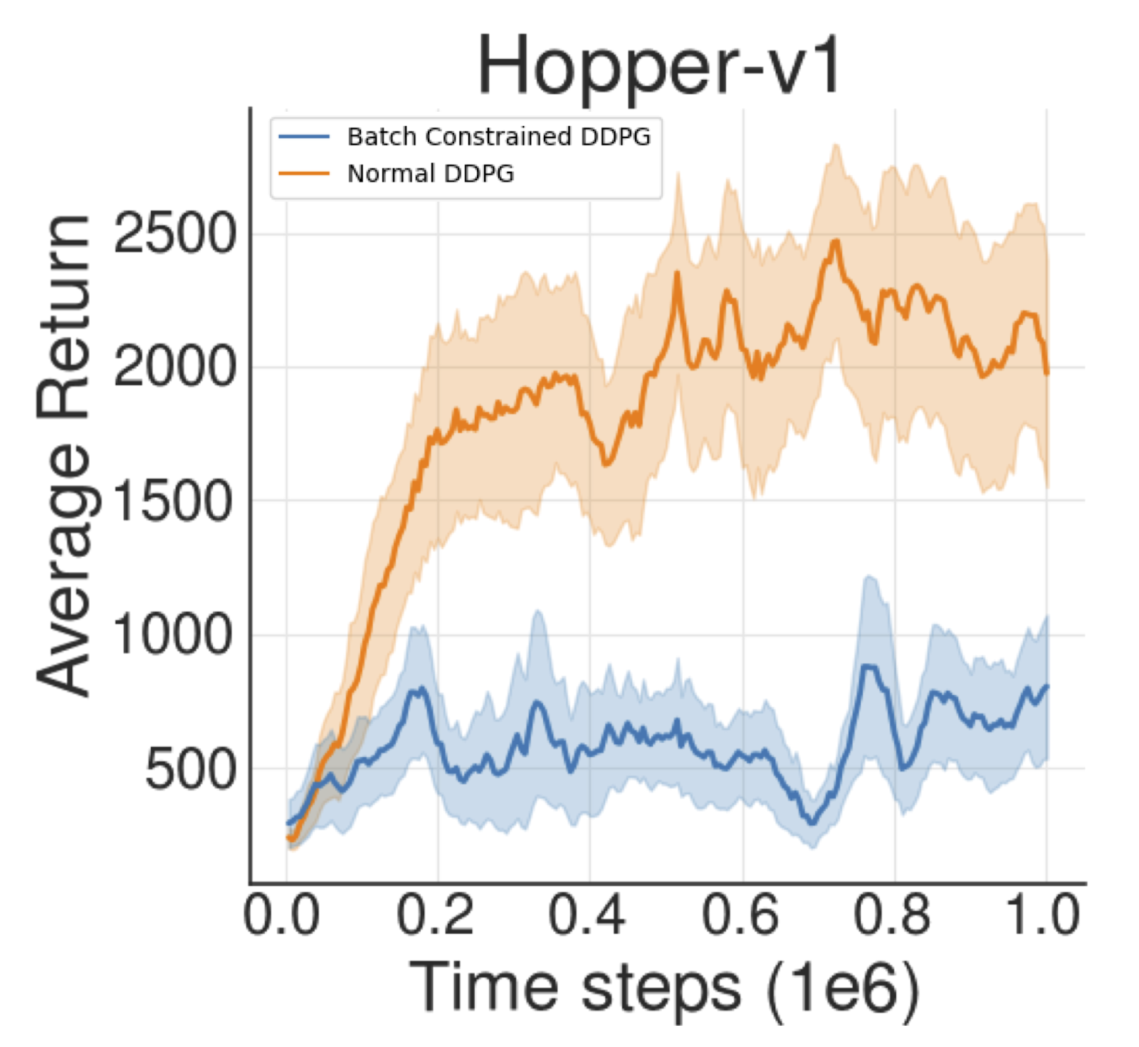
Surprise!!
Both agents are:
Trained with same dataset
Trained with same off policy algorithm - DDPG
Only difference: One interacts with environment, the other one doesn't

Slide 4
fails
Off-policy deep RL when truly off-policy!

Slide 5
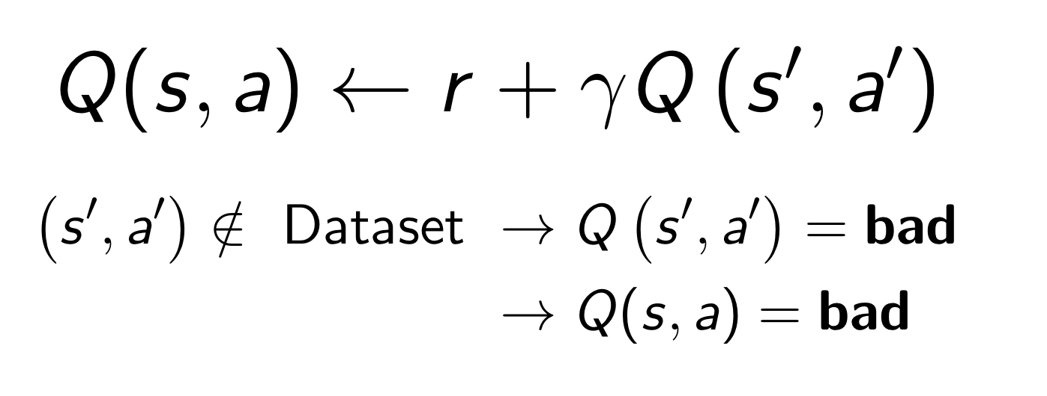
Why does this happen?
Transition to state s' where current policy takes action a'
Current policy takes action a
Current State s
Subsequently, this error will compound...

Slide 6
How can we get past this?
Simple!
While training, make sure all (s, a) encountered are close to data in the batch

Slide 7
State of the art for batch constrained setting:
Batch Constrained Q-learning (BCQ)
Key Ideas:
Minimize the distance of the selected actions to the data in the batch
Lead to states which are familiar and close to the dataset
Maximize the value function

Slide 8
Potential problems with BCQ?
Chooses actions that are close to dataset ​
If all actions in dataset are BAD?
STILL pick a BAD action...
Subobtimal Policy

Slide 9
BCQ fails to generalize when presented with data containing wrong actions.
Why?
BCQ has a hard constraint of choosing actions that are close to the data present in the batch
Solution:
Select actions based on both the vicinity to the batch data and expected long-term rewards

Slide 10
IMPROVED BCQ
Solution?

Slide 11
Key Ideas
Variational Autoencoder (VAE): Used to generate data similar to that of the batch while also trying to attain higher Q value.
Update Equation:
weight
weight
Action sampled from VAE
Q-value for sampled states and VAE generated actions
Action sampled from the batch
Maximize long-term reward
Minimize distance of generated action to the dataset

Slide 12
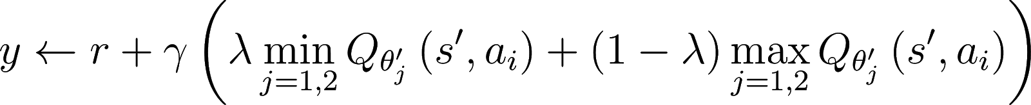
Key Ideas
Modified Clipped Double Q-learning : used to avoid overestimation of Q values.
Learning Target :
Action generated from VAE
Two Q-networks
Convex combination of two Q networks

Slide 13
Evaluation:
Two batch settings:
Concurrent Batch: Buffer data collected and stored while training a TD3 behavioral agent
Reversed Batch: Generated data from an expert TD3 agent, reverse actions and rewards for at least 20% of data
Reversed actions, Reversed rewards = What not to do

Slide 14
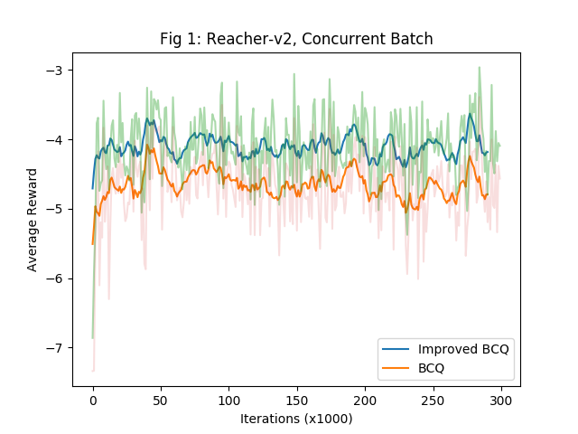
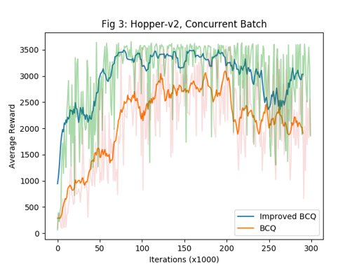
Results:
Both perform well,
But, since Q values are also maximized,
Improved BCQ > BCQ
Concurrent Batch

Slide 15
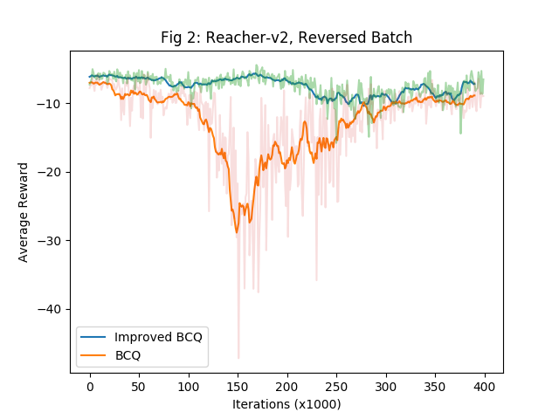
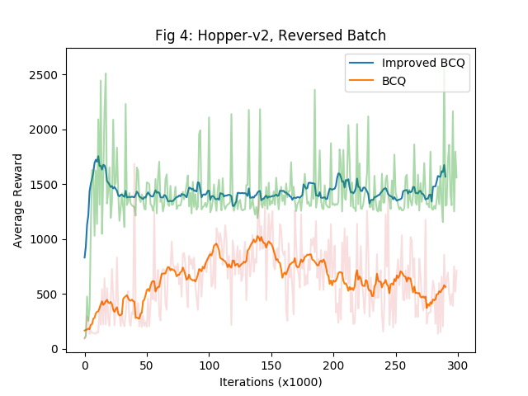
Results:
BCQ fails,
Cannot learn with reversed data,
Improved BCQ > BCQ
Reversed Batch

Slide 16
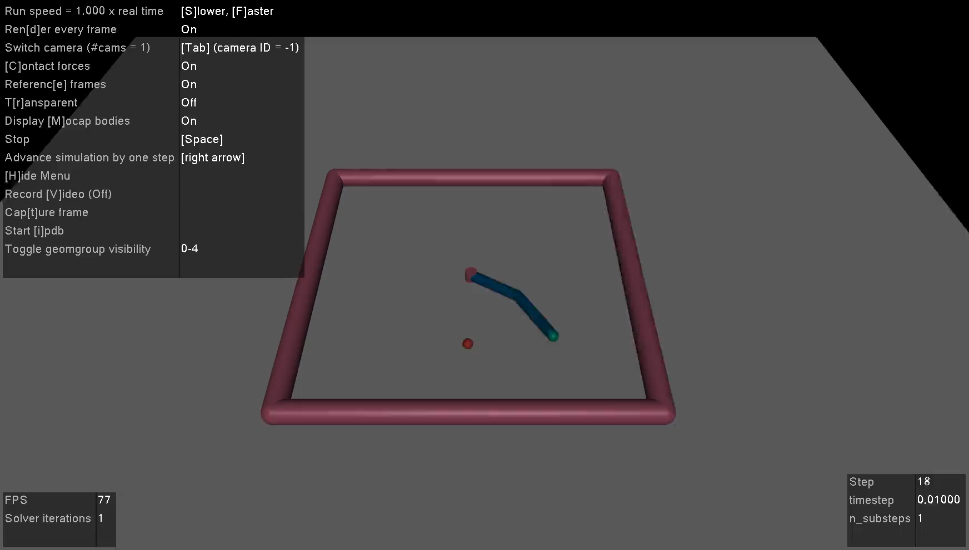
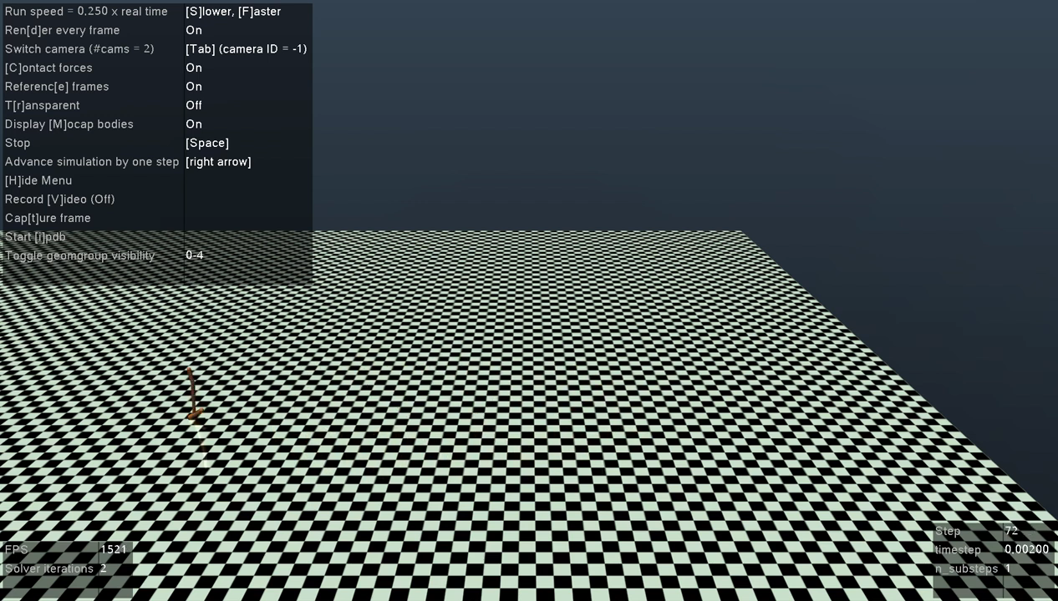
BCQ-Improved for Concurrent data
Reacher-v2
BCQ-Improved for Concurrent data
Hopper-v2

Slide 17
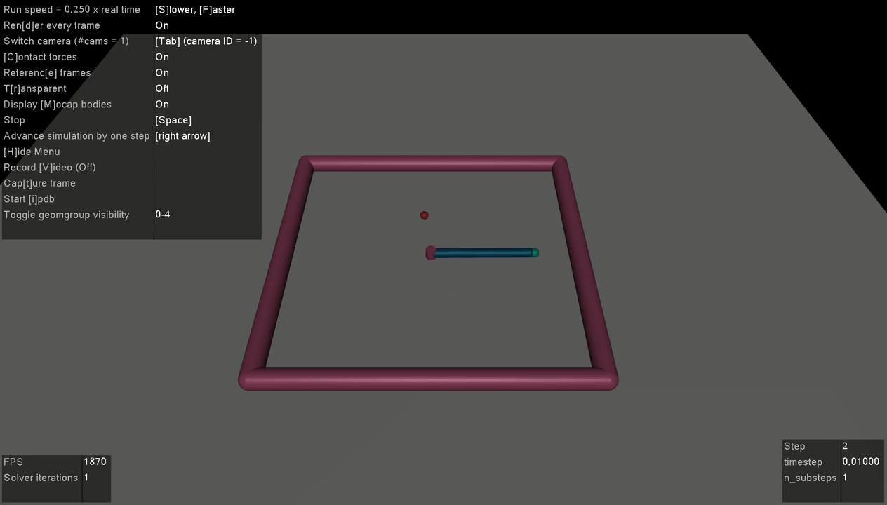
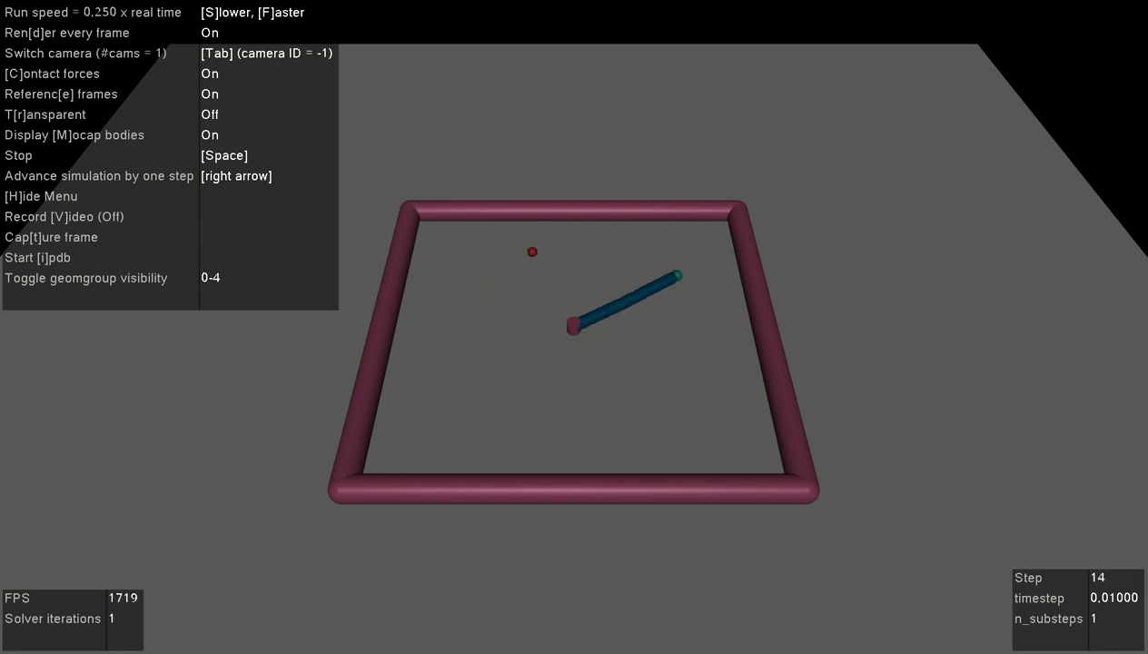
BCQ for reversed data
BCQ-Improved for reversed data

Slide 18
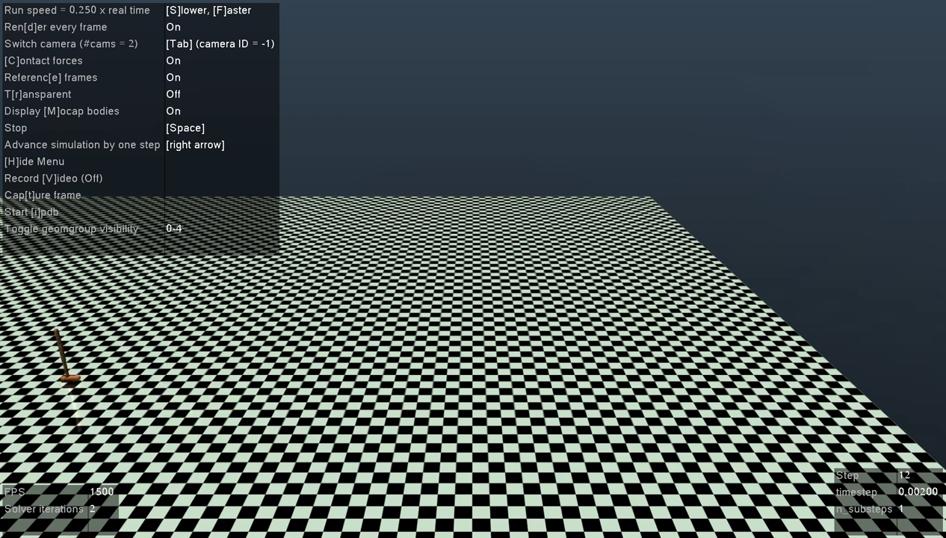
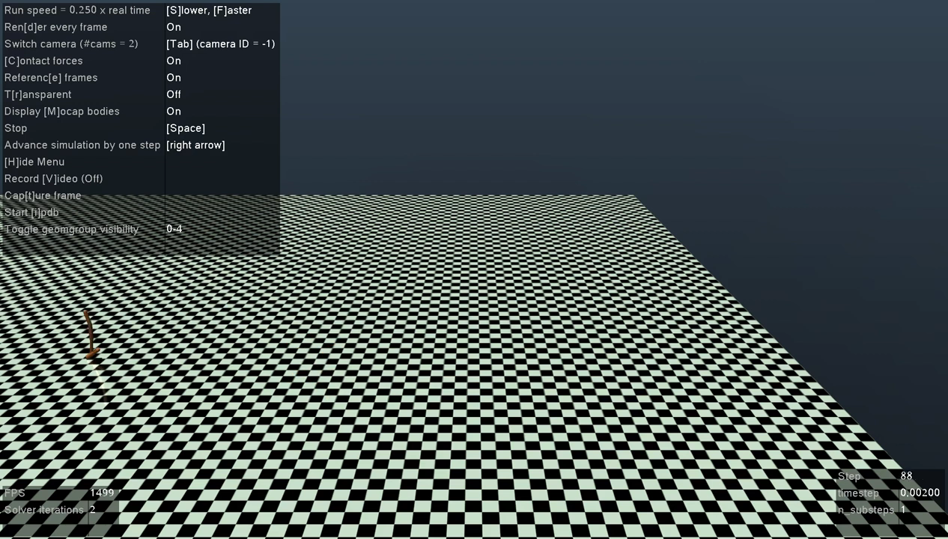
BCQ for reversed data
BCQ-Improved for reversed data

Slide 19
Inspired by:
S. Fujimoto, D. Meger and D. Precup, “Off-Policy Deep Reinforcement Learning without Exploration”, Proceedings of the 36th International Conference on Machine Learning, ICML 2019, 9-15 June 2019, Long Beach, California, USA, pp. 2052-2062.

